Slide 1

Welcome to BMTC
Public bus transport provider for Bengaluru

Slide 2

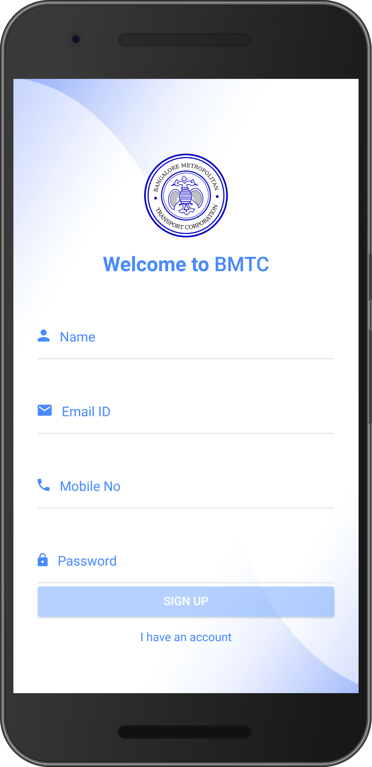
Sign Up
First step is to register or Sign up
Register with valid details like
Name
Email id
Mobile no
Password
Once click on SIGN UP button it will navigate you to Dashboard of the App

Slide 3
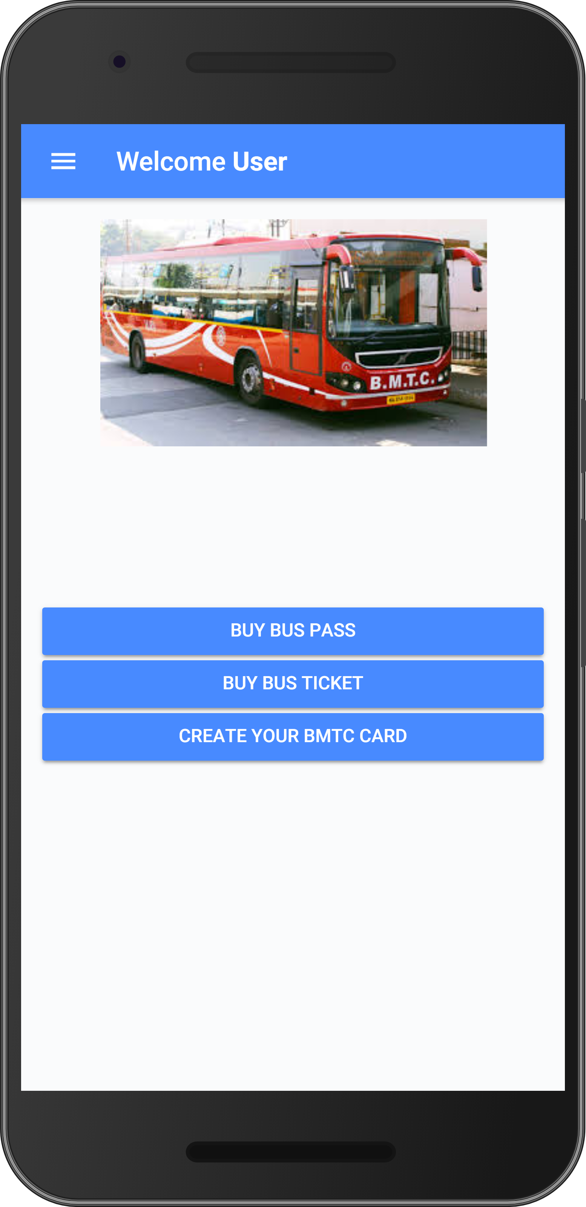
Dashboard
In Dashboard page there are 3 modules
Buy Bus Pass
- Here you can buy various pass types
Buy Bus Ticket
- Here you can Bus tickets
Create your BMTC card
- Here you can create your BMTC id card

Slide 4
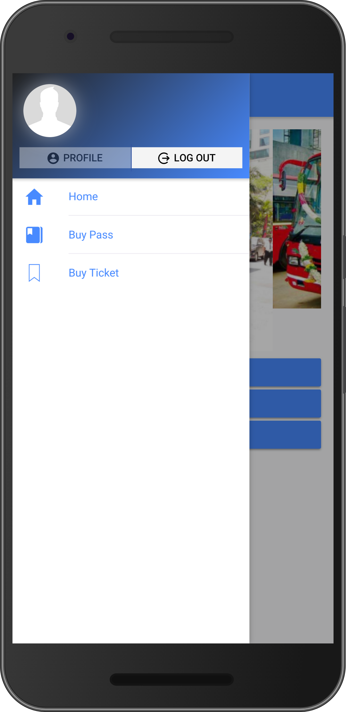
Side Menu
Side menu contains your profile and logout options, and included same options given in Dashboard

Slide 5
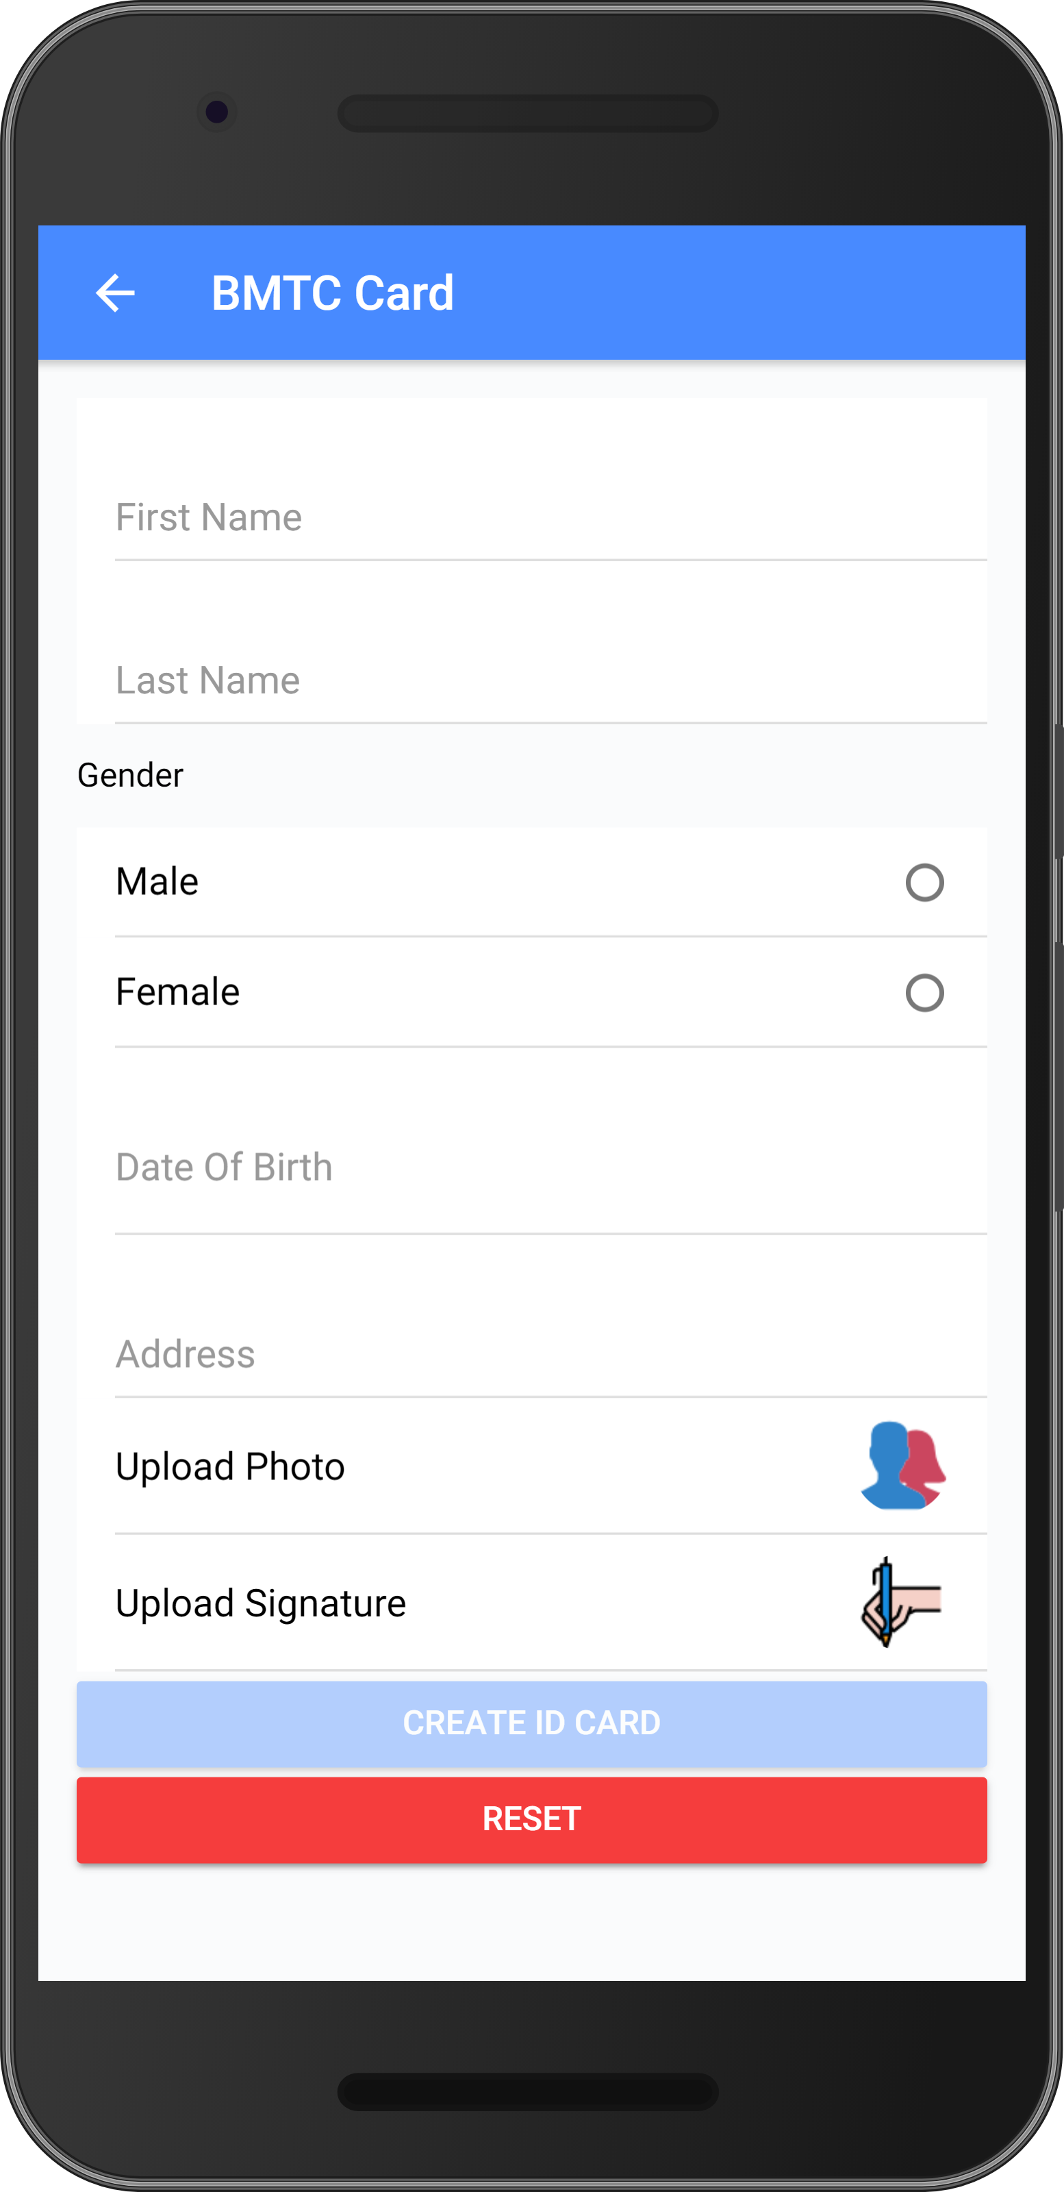
Create BMTC ID card
In Create BMTC ID card page, you can create your id card.
To buy any kind of pass BMTC id card is mandatory.
To create BMTC id card, you need to provide some details like
Name
Gender
Date of Birth
Address
Photo
Signature
Once you click on Create ID card button, your id will be created successfully and navigate to your Profile page.

Slide 6
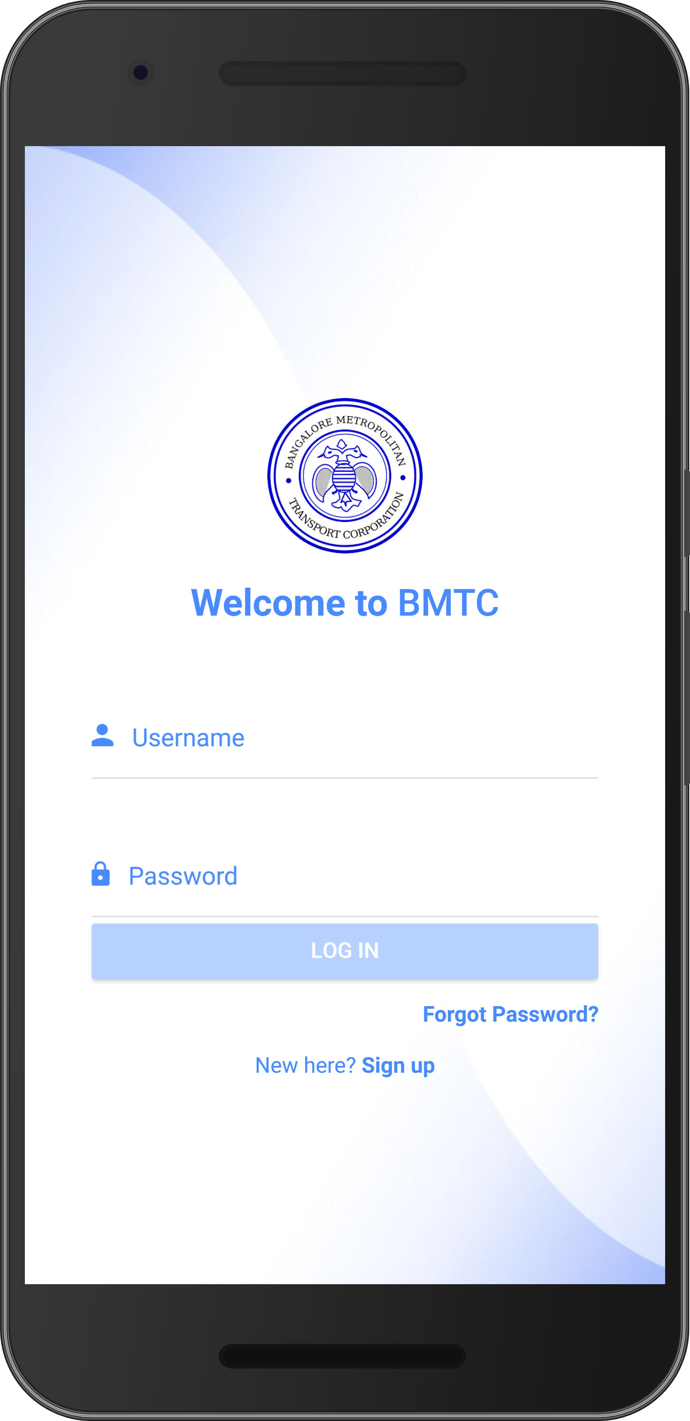
Login
This is Login page, where you can login to the App by providing valid credentials

Slide 7
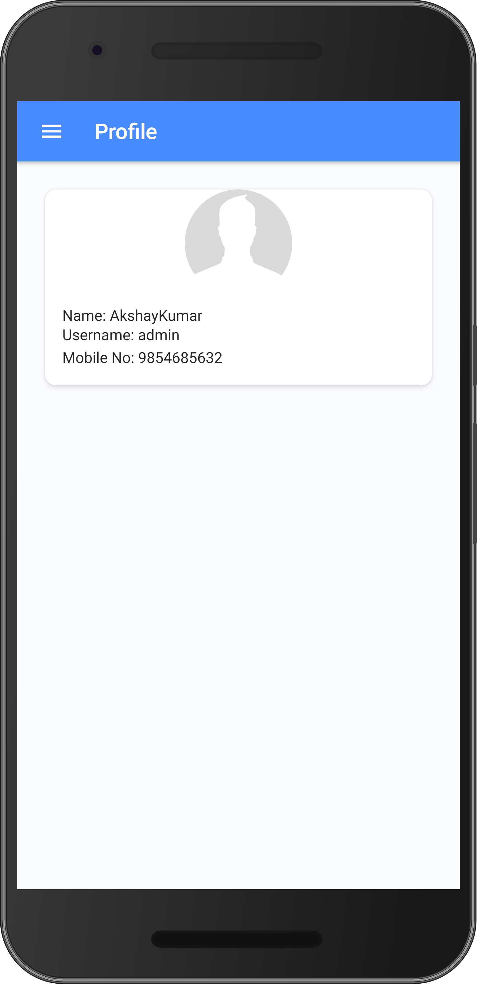
Profile
This is Profile page, when you click on Profile from side menu then you’ll get profile page where you can see user details.

Slide 8
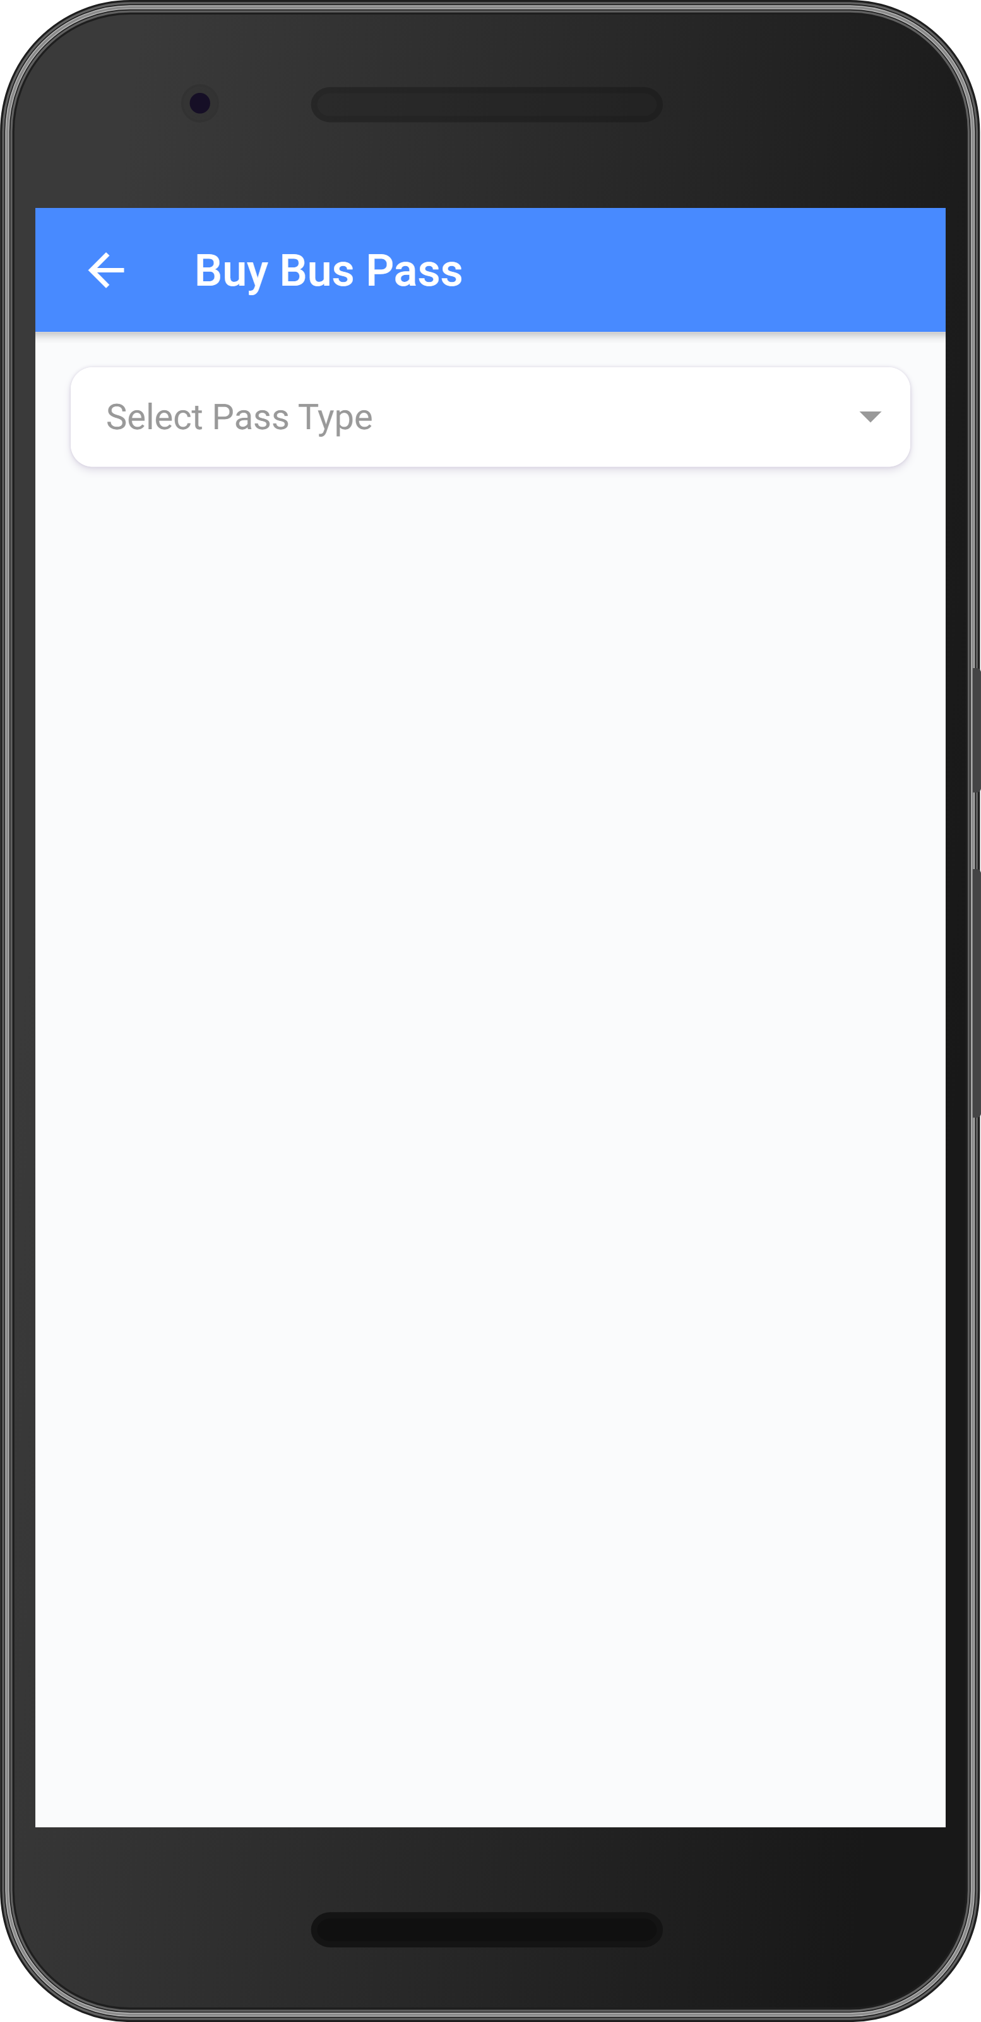
Buy Bus Passes - slide 1
When you click on BUY BUS PASS button from dashboard it will navigate you to this page.
Here you can select different types of passes

Slide 9
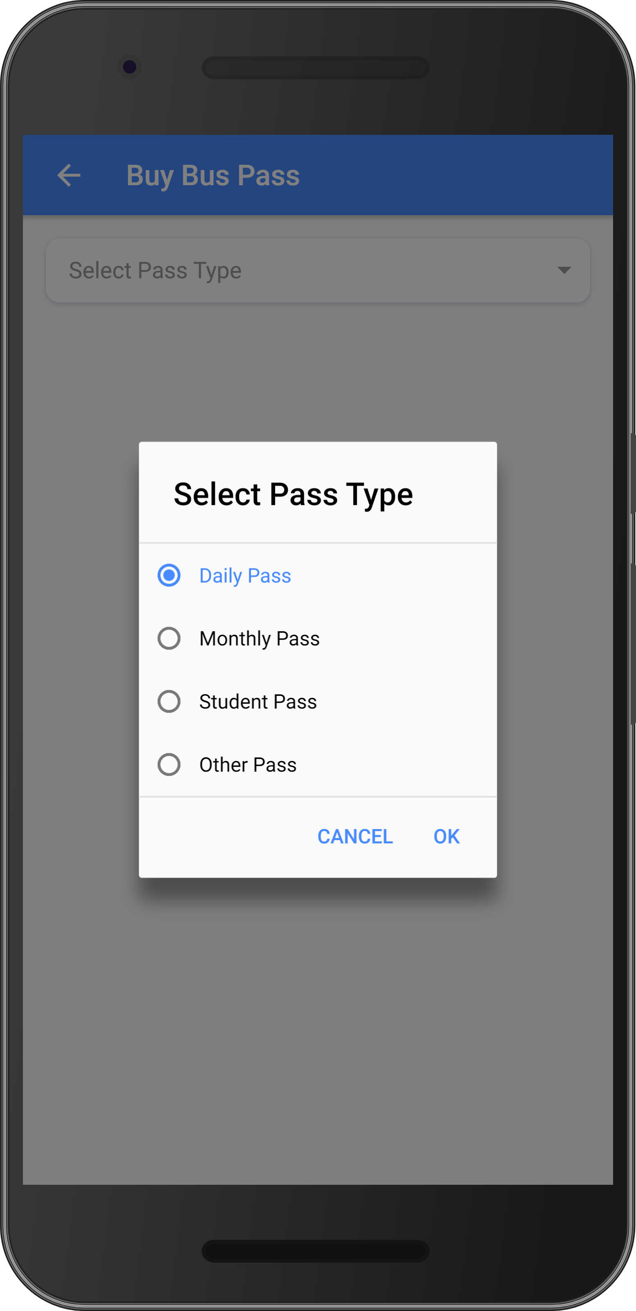
Buy Bus Passes - slide 2
Once you click on Select Pass Type drop down list it will pop up the pass types such as,
Daily Pass
Monthly Pass
Student Pass
Other Pass
Select any of the pass type and click on OK button, it will load all passes from the selected pass type.

Slide 10
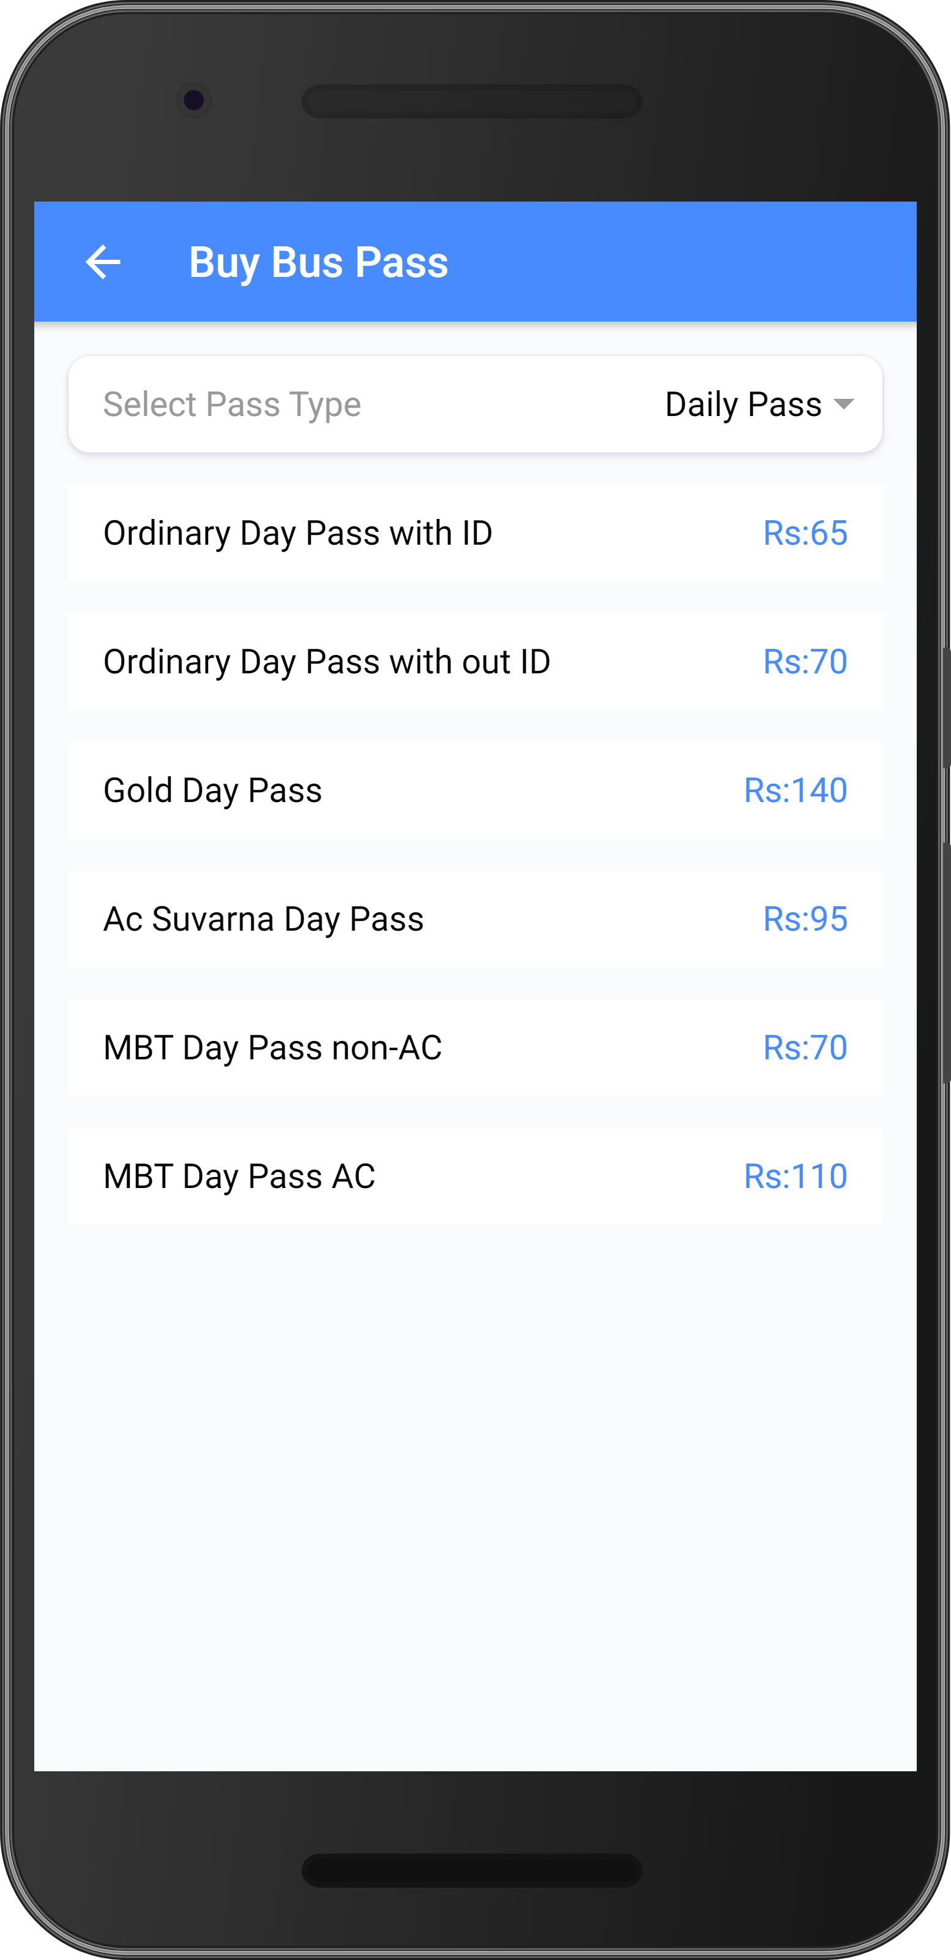
Buy Bus Passes - slide 3
In list view all the various passes are loaded, with description of pass and price.

Slide 11

Thanks!
Any questions?

